Slide 1

Our innovative project design: the hydrogen fuel storage proposal
T.I.B.H.s hydrogen connectors

Slide 2









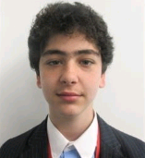
Meet our Team
Zeyad Elmetwally
Mission Strategist - -
Adam Mubarak -
Head Coder
Faaris Ahmed -
Project manager
Adam Ditta -
Communicator
Zakaria Master -
Researcher
Faaris Appliance Ahmed
Atom Ditta
Zeyad Electricwally
Adam Motorbarak
Zak Magnetic Master
Ammaar Mohsin-
Co Coder
Uzair Mitha - Builder
Uwais Mitha - Builder
Umar Saleh-
Team Captain
Ilkin Huseynov – Creative Designer
Ammaar Megawatt
Uzair Methanol
Uwais Methane
Umar Solar
Ilkin Hydrogen
Notes:
Give a nickname for each student – link it to energy. Done

Slide 3
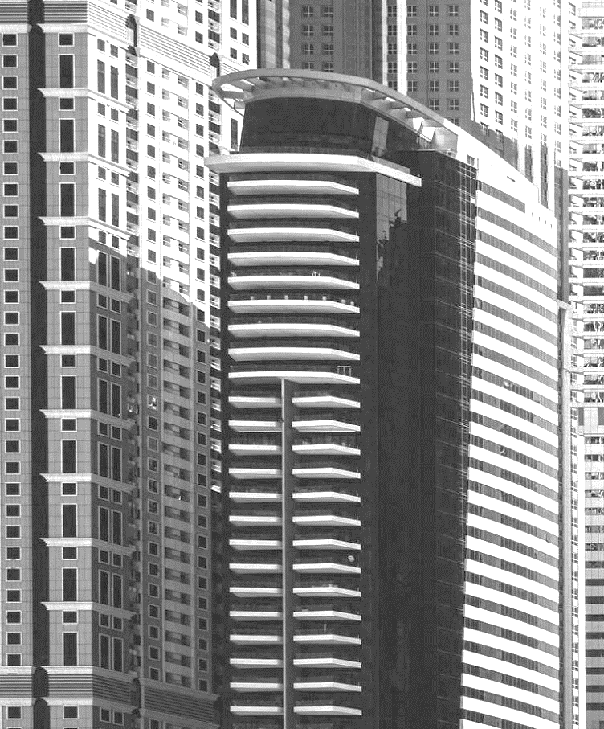

Solving the energy crisis in England:
In this year’s First Lego League competition we were tasked with finding a solution to the current energy crisis in England.
So as a team we have come together as one to find a solution, being power storage units, which can be installed in power grids (be it for stationary or transportation) to store excess energy using a renewable energy generator that will create 0 to little greenhouse gasses.
Notes:
Saleh In this year’s First Lego League competition we were tasked with finding a solution to the current energy crisis in England.
So as a team we have come together as one to find a solution, being power storage units, which can be installed in power grids (be it for stationary or transportation) to store excess energy using a renewable energy generator that will create 0 to little greenhouse gasses.
Saleh – link it to global warming and when you are expressing your views give an example of energy prices increasing “ the energy bill has increased by £300 in my 3 bedroom house…..”

Slide 4
What Is hydrogen?
Hydrogen is the most abundant element in the universe meaning that it is always readily available, it is estimated to contribute to 75% of the universe and is the key element for our design.
Makes up everything readily available 75% of universe
key
Notes:
Z.E
So we are going to be using hydrogen inside of our design, now hydrogen is……

Slide 5
Why Hydrogen?
Why hydrogen? Hydrogen can be used for the stationary or transportation energy sectors meaning it is a diverse energy for the future unlike solar or hydroelectricity which is purely stationary. Hydrogen can also be used to generate water as it is a by-product of the process. Wind & hydroelectricity can often harm the environment and during manufacture, transportation and solar installation can generate pollution.
Can be used for stationary/transport
Eco-friendly
Generates water and oxygen as a by-product
Manufacture poses no risk to environment
Notes:
Why hydrogen? Z.E

Slide 6
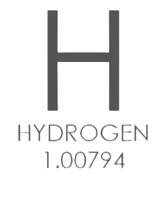
The design
Our design proposal is to split water into oxygen and hydrogen by using electricity. Subsequently, the hydrogen will be stored for later use in a hydrogen fuel cell where it is then contained and used to create electrical energy which will power our homes, factories, etc.
Filter water
Split into Hydrogen and Oxygen
Hydrogen condensed
Hydrogen used as fuel
Notes:
Zeyad
Whoever is doing this slide simplify it. Umar S simplify this. It’s been dumbed down – Ammaar M

Slide 7
How it works pt.1
Electrolysis System
No Carbon Emissions
Oxygen as a By-Product
Hydrogen from Atmosphere
Obtained from Sea Water
Purification before Energy Use
Small Power Grids to Power Neighborhoods
Notes:
Faaris - The first part of the design is an electrolysis system which converts water into hydrogen with oxygen as a by-product with no carbon emissions.
The water used for this process will be obtained from sea water which will be purified before it is converted into hydrogen for domestic use for small power grids used to power multiple homes to industrial scale factories.

Slide 8
How it works pt.2
Pressurisation
Freezing Hydrogen To A Liquid
Form Liquid Hydrogen
Stored In A Separate Tank
50mm Hardened S3 Steel
Energy In A Fuel Cell
Notes:
Faaris
The second part of this design converts this hydrogen gas into liquid hydrogen which is converted into energy in the fuel cell. This is done by pressurizing the hydrogen down into a liquid form by putting it into a cryogenic chamber which will convert the hydrogen into a liquid form and then storing it in a separate tank before being used as energy for the fuel cell.

Slide 9
How it works PT.3
Oxidisation
Excess Negative Charge To Energy
Medium (Filter)
Water And Oxygen As A By-Product
Process then Repeated
Notes:
Faaris
The third part of the design is the fuel cell which will convert the hydrogen atoms excess negative charge into electricity through a process called oxidisation, the process of reacting with oxygen, where the hydrogen atoms will travel through a filter that will collect any excess negative charge and thereafter will be converted into water molecules and other by-products by reacting them with air from an open pipe on the opposite side of the filter.
Umar Saleh - (ZE will tell you a simplification, lead with something akin to, “now what my colleague told you may be might complicated, which it is, but I’m here to simplify it for you…”)

Slide 10
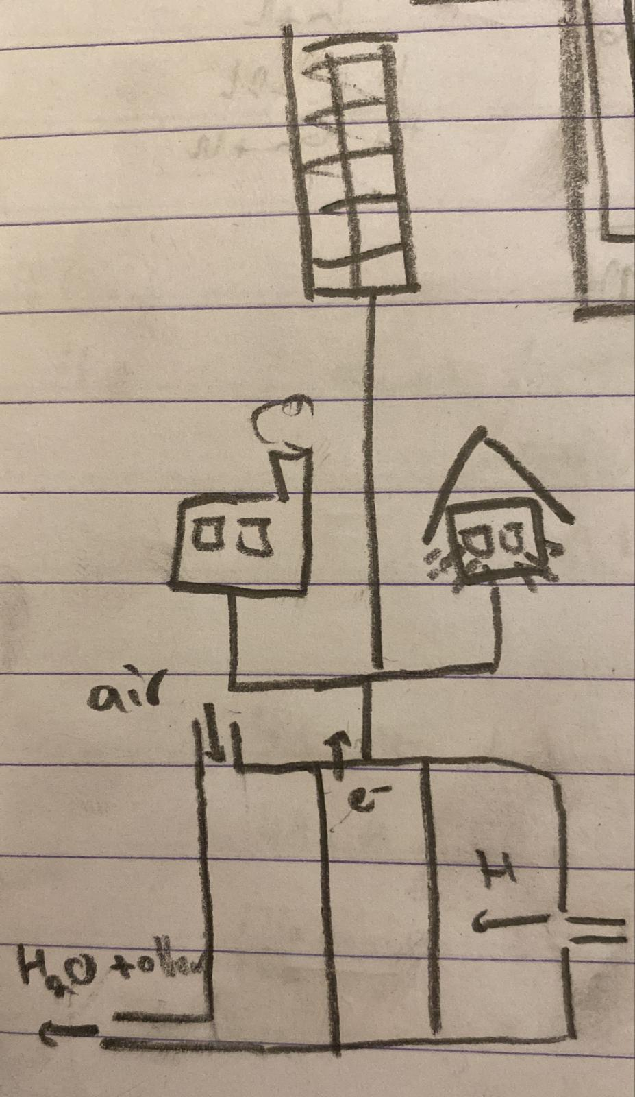
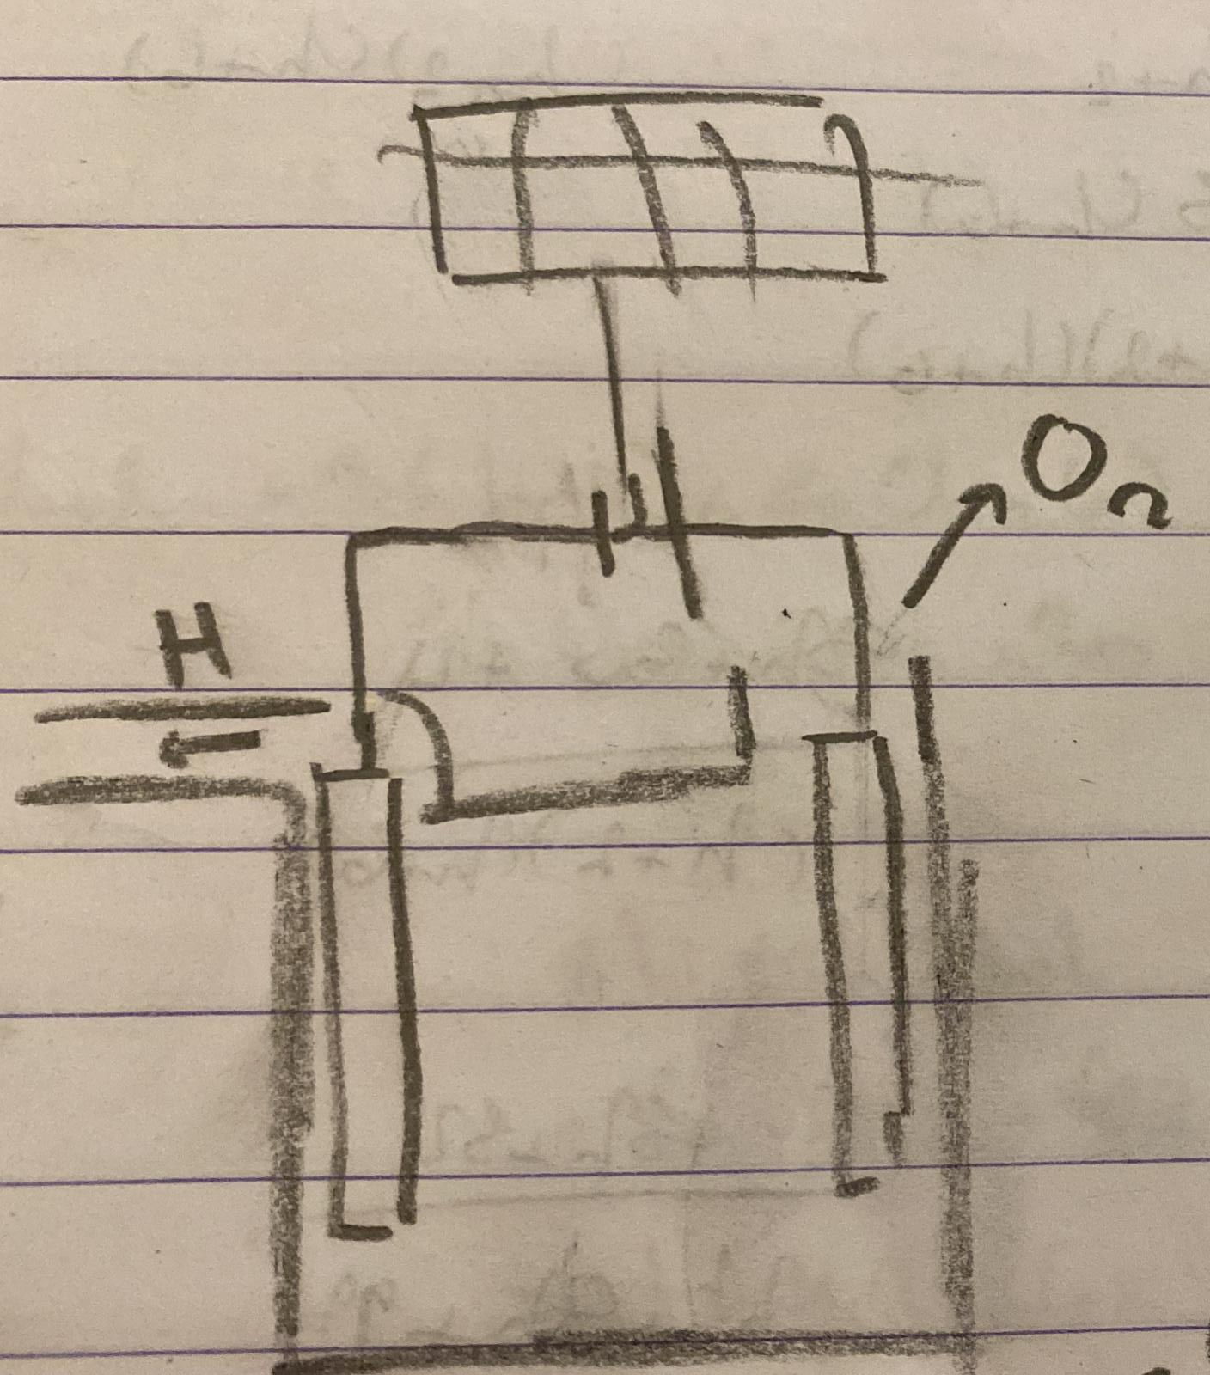
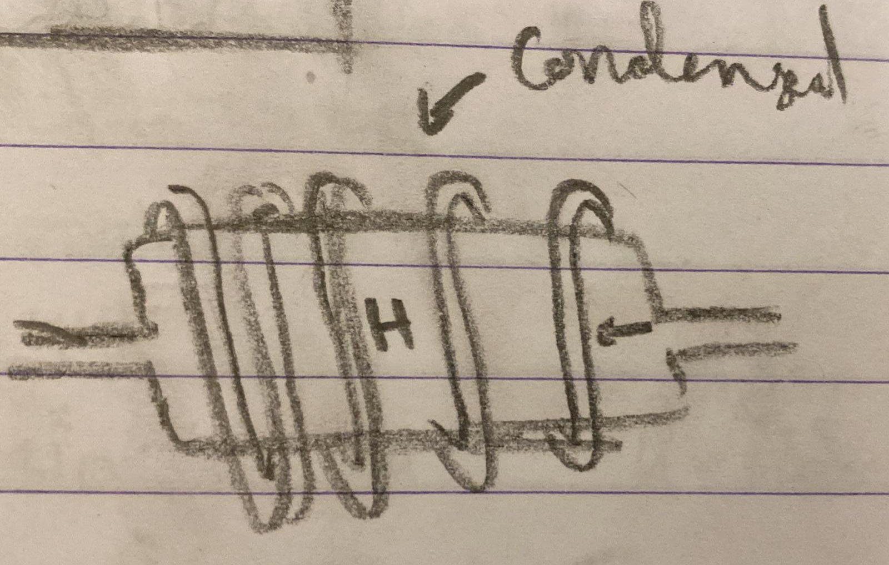
Some Concepts we came out with:
These are a few concepts our team designed together whilst working on our hydrogen energy design.
Notes:
FA explain this sketch Also roleplay will be done after this slide. Done

Slide 11
Innovation prototype

Slide 12
Roleplay
In Townville, there is a catastrophic energy crisis. People need electricity in their homes and the town's crazy scientist has just found the solution...
Now a few of our colleagues will be demonstrating a roleplay to demonstrate the impact of our hydrogen energy.
Notes:
Ammaar

Slide 13

Statistics & Research
250–693 Wh/L – Lithium energy density 120 and 142 MJ/kg – Hydrogen energy density
Statistics
Our hydrogen design is extremely efficient.
According to British Gas, Ofgem and many other websites the average household uses 2,900kWh annually.
Research
Hydrogen has started to commonly be used by many multi-national industries such as N.A.S.A. to generate fuel as well as using the by-product of water to supply astronauts on missions.
Notes:
Z>E

Slide 14
Hydrogen holds great promise to meet many of our future energy needs and it addresses our environmental concerns.
“
”
—Dan Lipinski, Representative of the United States of America
Notes:
US

Slide 15
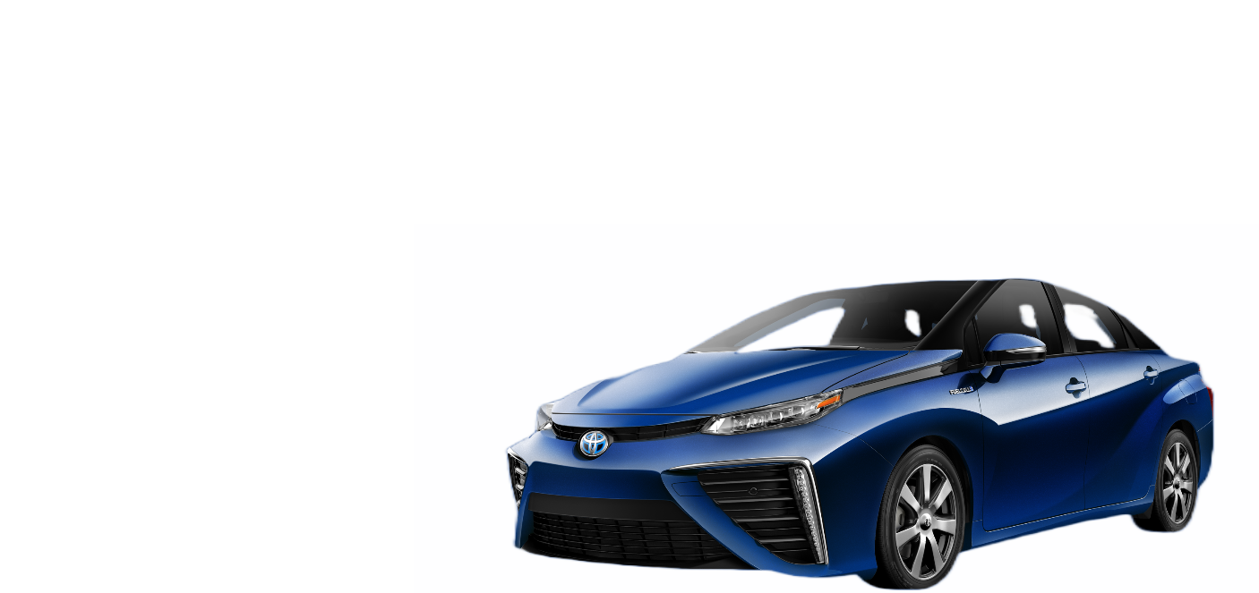
Inspiration
We took inspiration from Toyota Mirai cars which utilise hydrogen fuel cells to power their cars.
We used a concept based on their hydrogen fuel cells along with an electrolysis process to make our innovative design.
A Toyota Mirai
Notes:
Saleh

Slide 16
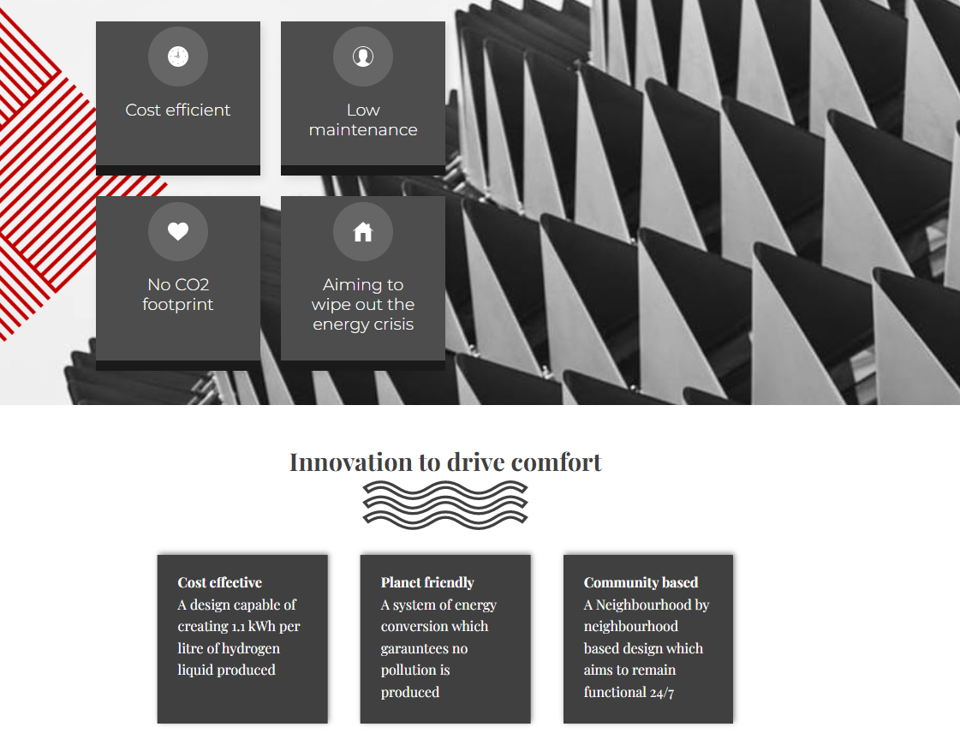

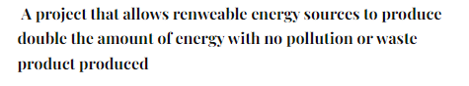
Website of our design
Enter this URL to see our website: https://projecth2.3dlaboratories.co.uk
As we move towards an economically sustainable future, please use this QR for our website:
Notes:
Zeyad – link to website. Done
Uzair? – link to leaflet.

Slide 17
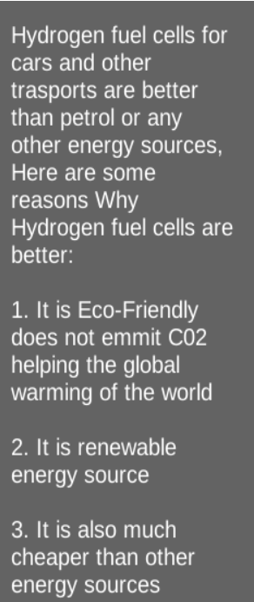
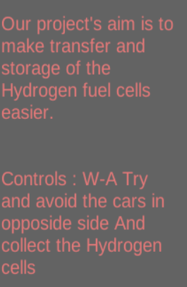

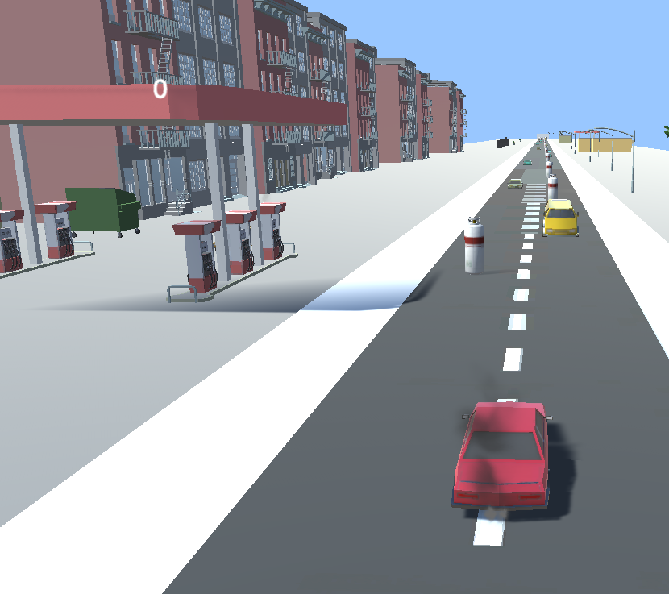
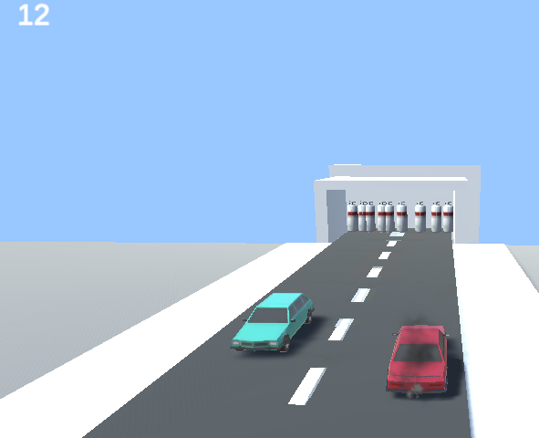
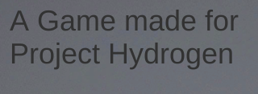
The Game
Project Hydrogen
Notes:
Game Link To Be Added Here (Ilkin has file?)

Slide 18
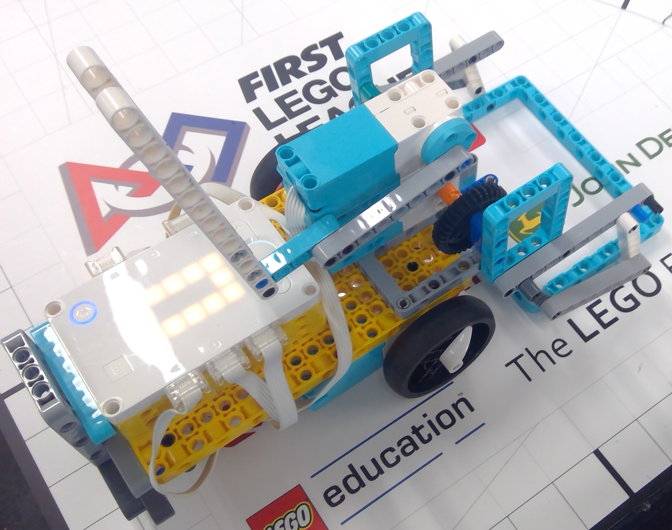
Our Robot Design
Our robot is designed using a medium sized frame for balance with 2 wheels for maximum acceleration and efficient turning. We have placed a gyro on the back for accurate turning as well as 2 motors on top of each other to stop obstruction as well as being able to easily switch attachments in the competition.
Notes:
Adam

Slide 19
THE ROBOT
-We found the challenges quite difficult, we had some setbacks, but we managed to overcome the setbacks and complete as many challenges as time allowed us to.
-We also had lots of designs prior to the final design you see here-we were unsure which model would be best, so we experimented until we found that perfect design.
-The attachments also took a lot of time, working out and thinking. We needed something so that we could complete most if not all the challenges without changing the attachment, to save time, and earn bonus points. If this was not enough, we also had to take into consideration the height restrictions and design a second attachment that was also universal.
Notes:
Adam

Slide 20
Design Issues
One major design issue we encountered during our initial construction of the robot was that the single motor for our attachments was located too _{low-lying}. This was fixed through trial and error and slowly ^{raising} the attachment motor and carefully adjusting our attachments until we found a satisfactory substitute. However, through hard work and perseverance from the entire team we were able to fix these issues.
Notes:
Adam

Slide 21



SUMMARY
In our design we have gone through multiple iterations of how hydrogen works and several discussions on the energy source we will be using for our innovative project as well as referral from our elder peers; we came to an agreement with our joint efforts on the hydrogen storage project shown by our innovative model and hope that our design can be implemented to face the current energy crisis in the UK.
Notes:
Saleh – talk about teamwork. Added on.

Slide 22
THANK YOU for listening. Any questions?
From:
T.I.B.H.s hydrogen connectors

